Slide 1
0x402 – Exploring C to ASM
ECED4406 – Computer Security
Dr. Colin O’Flynn
Dalhousie University.

Slide 2
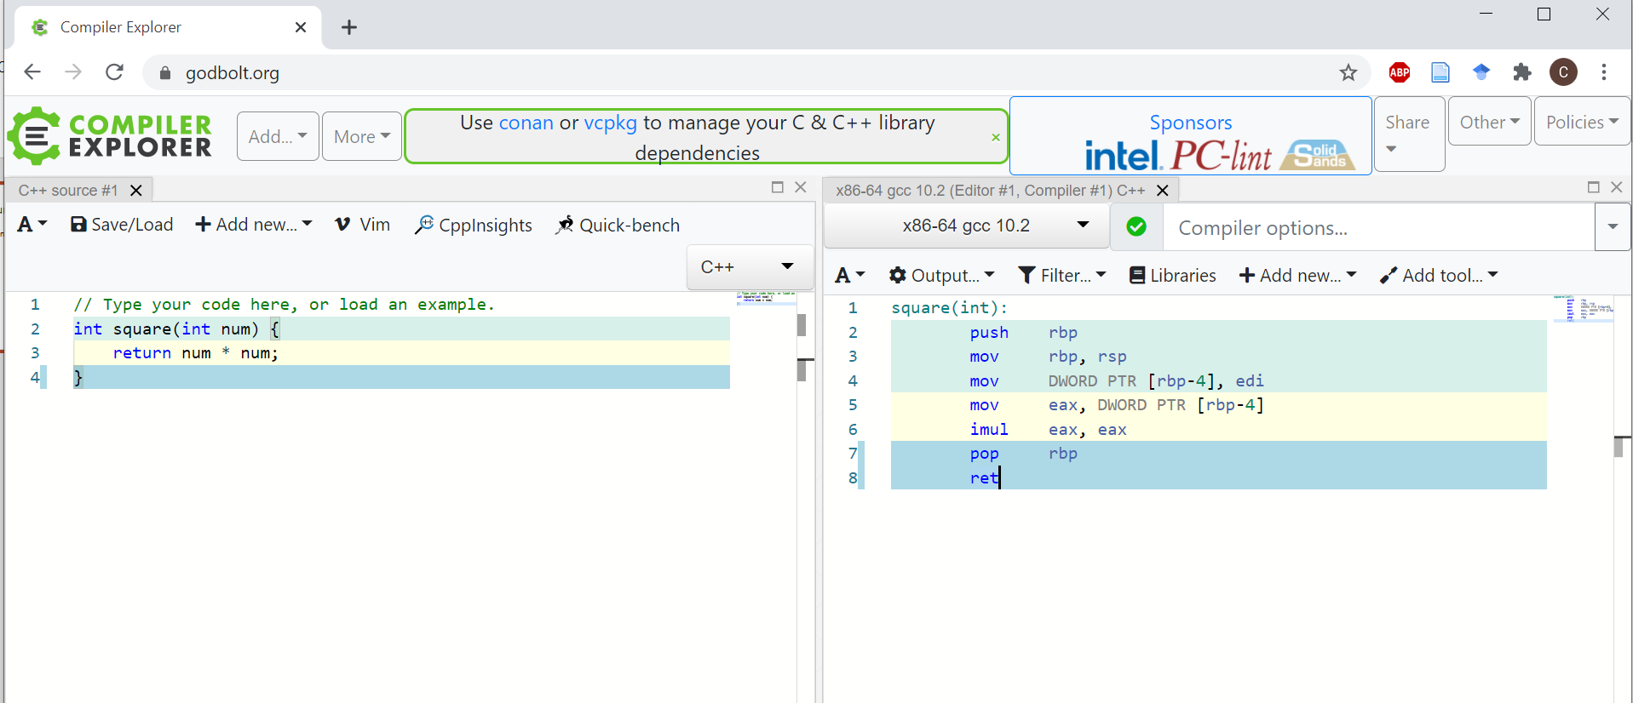
This Lecture will use Compiler Explorer
Available online at Godbolt.org (made by Matt Godbolt)

Slide 3
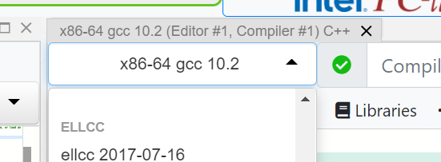
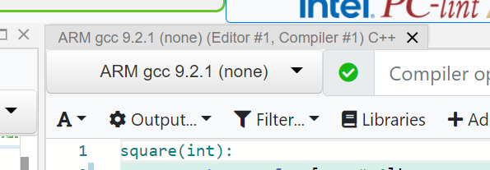
Set the compiler type

Slide 4
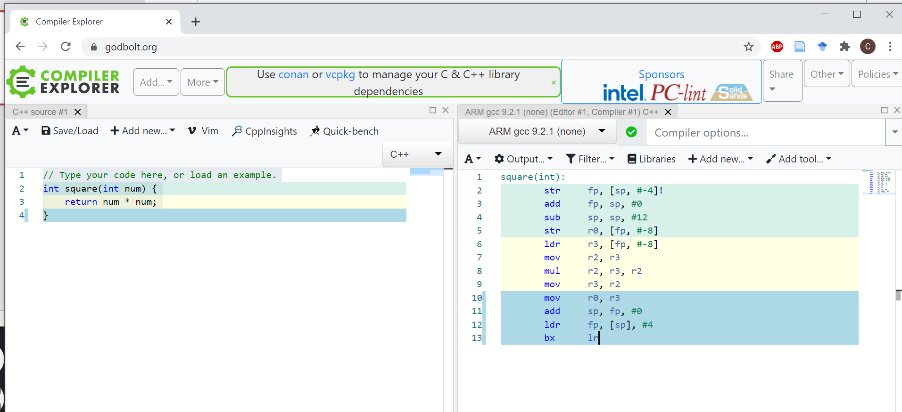
Default Example Code

Slide 5
How does it work?
Compiles C code on left to ASM on right.
Applies optimizations – if your code does nothing it may get optimized away (just like in real life).
You can call external functions, the assembly for them won’t show up.

Slide 6
Try the following codes:
A “for” loop
Addition operations
Multiply operations
Calling other functions

Slide 7
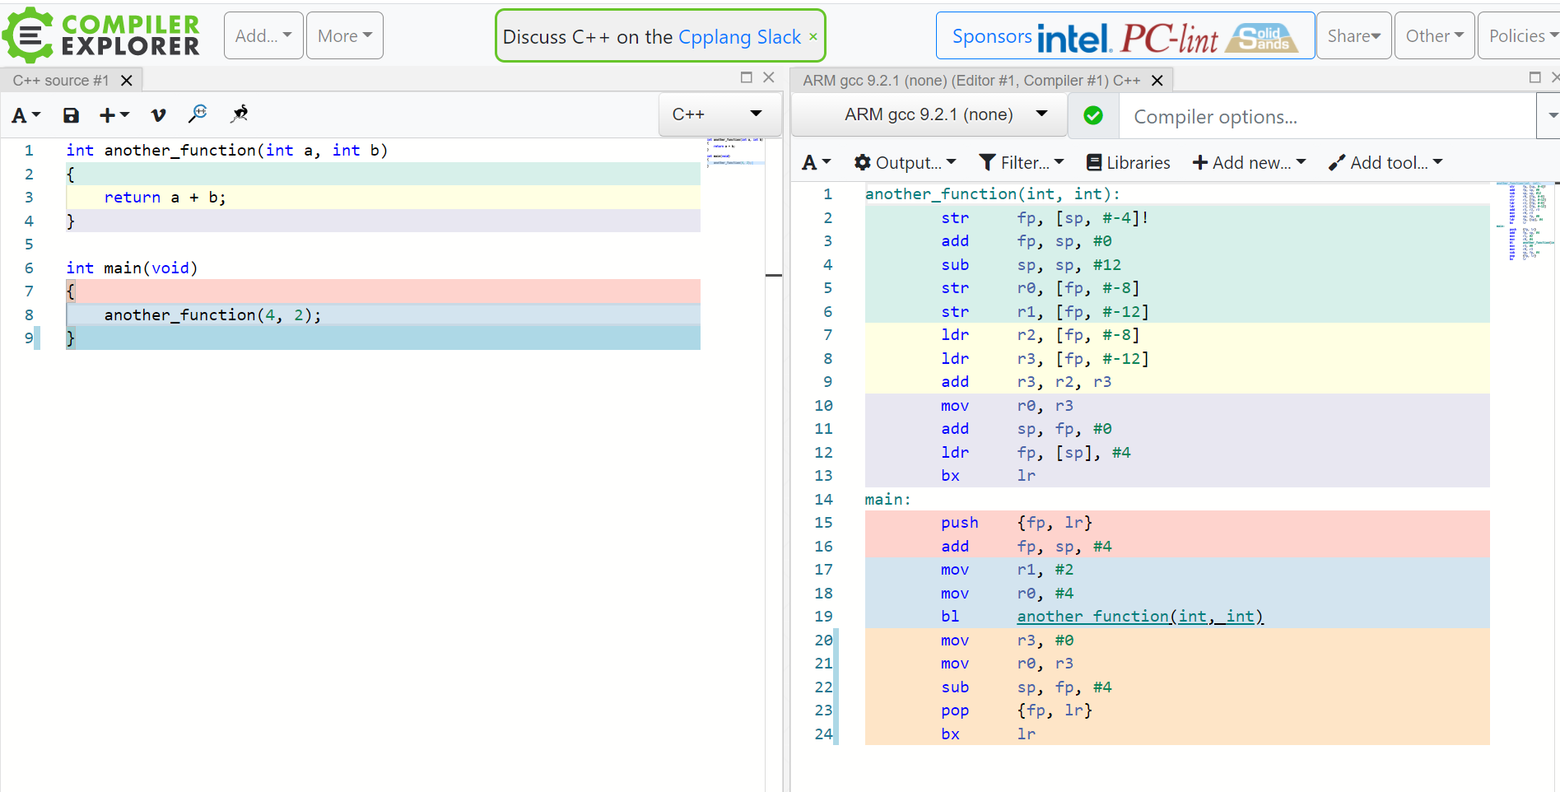
Example: Calling other functions

Slide 8
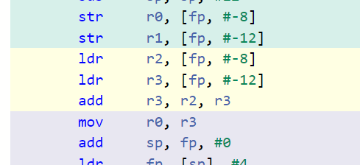
Questions for Quiz – use Compiler Explorer to answer the following…
What is the assembly instruction for addition of numbers?
When calling a C function, where does:
The first argument go?
The second argument go?
When does it stop using this method?

Slide 9
Hint – to see how arguments are stored
int another_function(int a, int b, int c, int d, int e, int f, int g)
{
return a + b;
}
int main(void)
{
another_function(4, 2, 5, 6, 2, 4, 2);
}

